Slide 1
2014 Review & 2015 Preview Calendar
JANUARY
SUNDAY | MONDAY | TUESDAY | WEDNESDAY | THURSDAY | FRIDAY | SATURDAY
 |  |  | 31 NEW YEAR’S EVE | 1 NEW YEAR’S DAY OFFICE CLOSED | 2 OFFICE CLOSED | 3
4 | 5 Program/Unit Managers Deadline to Request 360 Peer Evaluations | 6 | 7 | 8 | 9 360 Peer Evaluations Due to Program/Unit Managers | 10
1 | 12 | 13 | 14 | 15 | 16 Employee’s submit to Managers : Draft 2014 Goals & Performance Form 2015 Employee Goals & Performance Expectations Form | 17
18 | 19 MLK OFFICE CLOSED | 20 | 21 | 22 | 23 Employee’s submit to Managers: Final 2014 Goals & Performance Evaluation Form 2015 Employee Goals & Performance Expectations Form | 24
25 | 26 | 27 Program/Unit Manager Reviews Due to F&A Program/Unit Manager Submits Final Employee Reviews to F&A | 28 | 29 Employee and Program/Unit Manager Evaluations submitted to President’s Office by F&A | 30 | 31

Slide 2
2014 Review & 2015 Preview Calendar
FEBRUARY
SUNDAY | MONDAY | TUESDAY | WEDNESDAY | THURSDAY | FRIDAY | SATURDAY
1 | 2 | 3 | 4 | 5 | 6 | 7
8 | 9 | 10 | 11 | 12 | 13 Senior Management One-on One Reviews Due | 14
15 | 16 PRESIDENTS DAY OFFICE CLOSED | 17 | 18 | 19 | 20 Presidents Office Submits Final 2014 Performance Documents to F&A | 21
22 | 23 | 24 | 25 | 26 All Staff Review-Preview (Tentative) | 27 All Staff Review-Preview (Tentative) | 28

Slide 3
2014-2016 Strategic Plan
Build a Financially Sustainable Organization
Ensuring that Partners remains strong and influential is our top priority.
We all must make the necessary effort and time investment into sustaining Partners mission and strengthening our capacity to be financially independent.
The goal here is to “hold and expand” our core activities in areas such as Youth Engagement and in programs like A Ganar, Farmer to Farmer and the various professional leadership exchanges that we manage with the Department of State.
At the same time, all must put a renewed emphasis on putting the infrastructure in place that will allow Partners to capitalize on new opportunities and develop unsolicited proposals in which we can champion new ideas that leverage the talent of our growing network of volunteers and affiliated institutions.
Strengthen Our Network
The core strength of Partners has always been its ability to connect individuals and organizations across the hemisphere and amass a network that is greater than the sum of its parts.
Today we are creating a revitalized network of volunteers, civil society organizations, businesses, universities, governments and collaborators of all forms.
We need to place renewed emphasis on learning and educating ourselves about the many ways to position Partners.
We are in a new era and need to be learning-ready, proactive, and able to make connections and collaborate meaningfully across program areas.
3. Create an Accountable and Transparent Organization
Partners must continually nurture its relationship with donors, grant-writers and all those who support our mission.
To inspire trust and confidence in our operations, it is imperative that Partners create a climate of transparency and accountability, in which contributors can freely access financial and programmatic information.
Through clean audits, an efficient governance structure, on-time submissions of quarterly and annual reports, improving donor communication, and attaining BBB certification, Partners will be able to ensure supporters that their contributions are wisely invested and buttress our reputation among competitors and members alike.
4. Evaluate and Communicate Our Impact and Value
In progress

Slide 4
2014 Goals & Performance Review Process Part I Employee Reviews

Slide 5
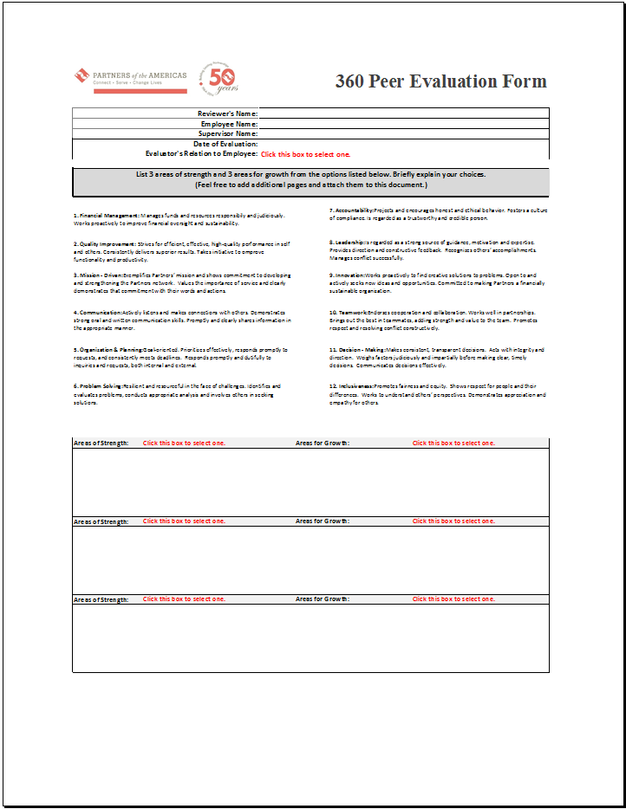
Supervisors will request two or three (2 min.-3 max.) confidential 360º Peer Evaluations from colleagues of each employee.

Slide 6
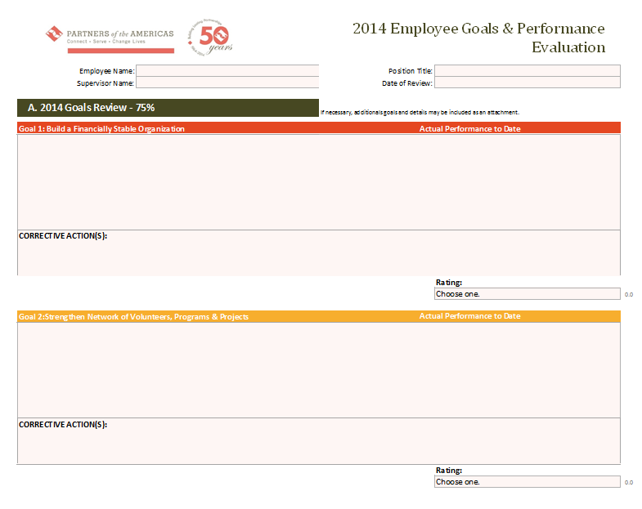
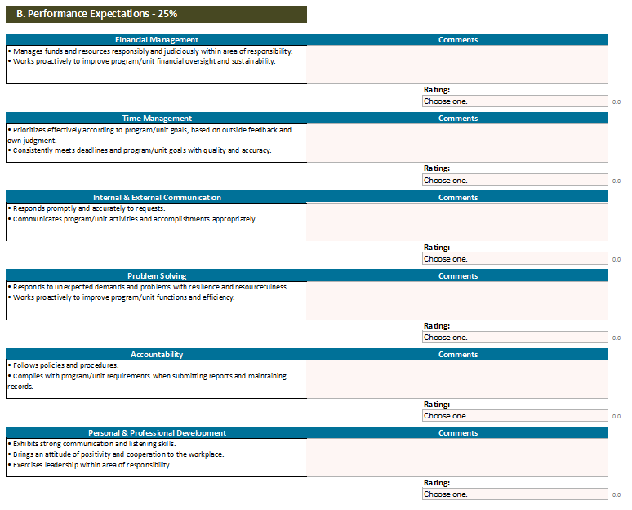
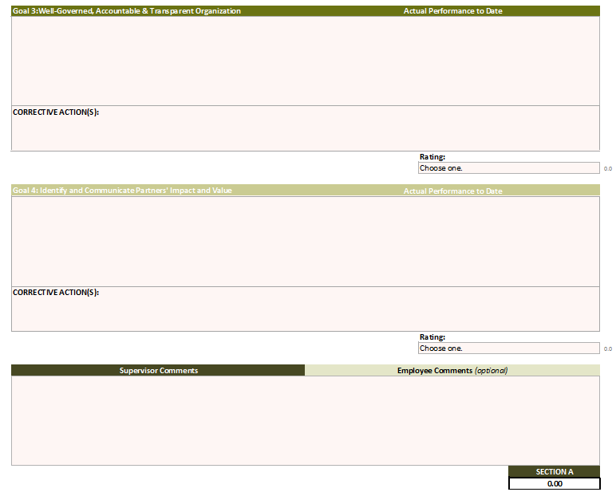
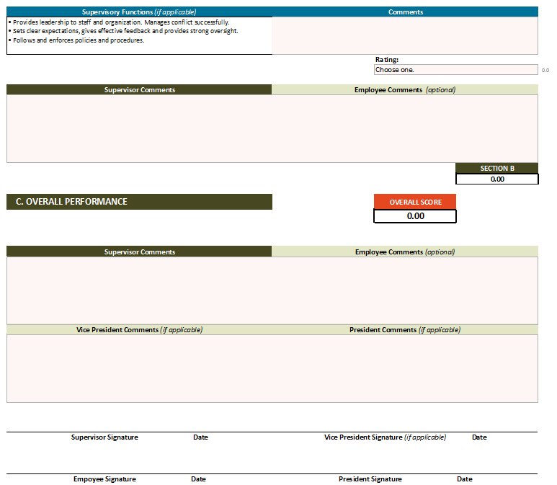
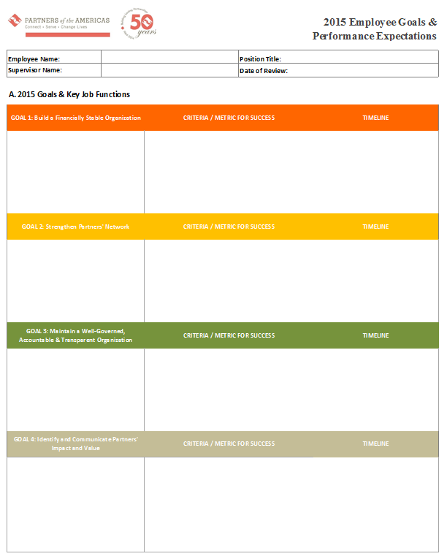
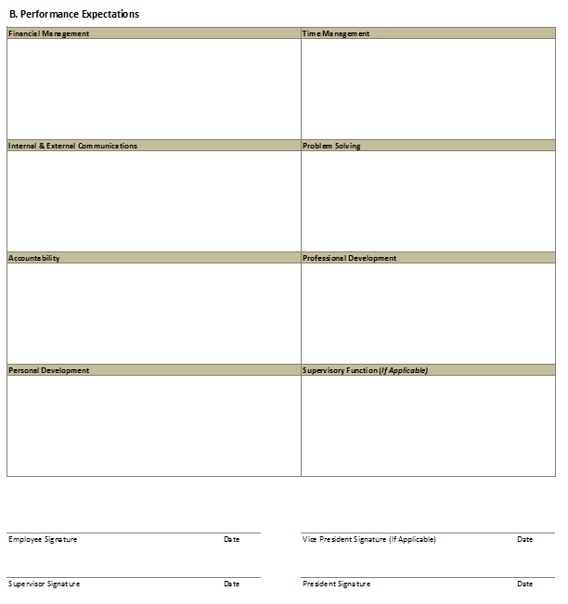
Supervisors will email each of their employees a copy of the 2014 Employee Goals & Performance Evaluation Form and the 2015 Employee Goals & Performance Expectations Form.
In the email, Supervisors will ask the employee to fill in Section A and Section B with the ratings that they believe they have earned for that specific goal. Employees must also complete the 2015 Employee Goals & Performance Expectations Form at this time.
Once the employee completes the 2014 Employee Goals & Performance Evaluation Form and the 2015 Employee Goals & Performance Expectations Form in its entirety, they will email the completed forms to their supervisor.

Slide 7
Once the Supervisor receives the completed 2014 Employee Goals & Performance Evaluation Form and the 2015 Employee Goals & Performance Expectations Form, they will promptly set a date and time to meet with the employee.
The objectives that should be achieved during the one on one meeting are as follows:
For the supervisor and employee to discuss the ratings and comments on the 2014 Employee Goals & Performance Evaluation Form.
Review the 2015 Goals & Performance Expectations Form.
Supervisor and employee to agree on the final ratings that will be submitted to F&A.

Slide 8


After the one on one meeting has taken place. The supervisor will finalize the 2014 Employee Goals & Performance Evaluation Form and the 2015 Employee Goals & Performance Expectations Form by entering all final data. The supervisor must also complete the Salary Increase Form if applicable.
The forms must then be printed and signed by both the employee and supervisor. Supervisors will then turn in all final documents to F&A.
Please only submit hard copies, not soft copies of employee documents.
This will conclude the employee review (Part I) and begin the supervisor’s evaluation process (Part II).

Slide 9
2014 Goals & Performance Review Process Part II Program/Unit Manager Reviews

Slide 10
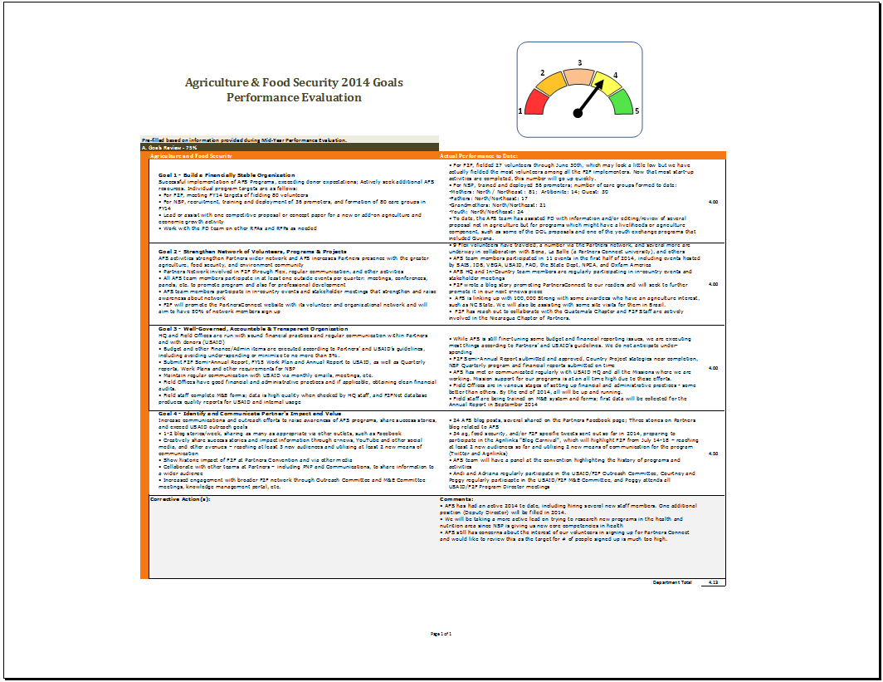
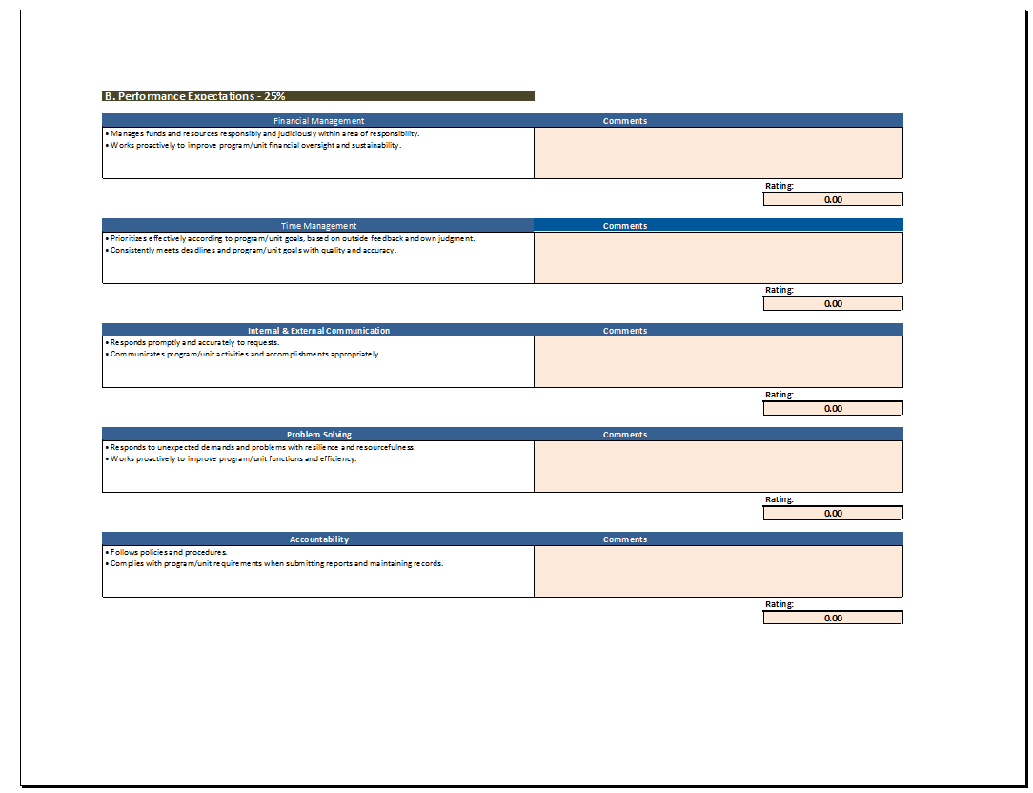

Program/Unit Managers will be evaluated based on performance in achieving their 2014 Program/Unit goals.
F&A will email each Program/Unit manager their respective 2014 Program/Unit Goals & Performance Evaluation Workbook (See Example Below) and a blank 2015 Program/Unit Goals Form.
The workbook is pre-filled based on data given and presented during midyear reviews.

Slide 11
Program/Unit Managers will update Section A. with the information as needed, including the ratings. They will also complete Section B. by entering the ratings they believe they have earned.
Once this has been completed, Program/Unit Managers will email their 2014 Program/Unit Goals & Performance Evaluation Workbook and 2015 Program/Unit Goals Form to Senior Management and schedule a one on one meeting to review their ratings.
The objectives that should be achieved during the one on one meeting are as follows:
For the Program/Unit Manager and Senior Management and to discuss the ratings and comments on the 2014 Program/Unit Goals & Performance Evaluation Form.
Review the 2015 Program/Unit Goals Form.
Program/Unit Manager and Senior Management to agree on the final ratings and goals that will be submitted to F&A.

Slide 12
After the one on one meeting has taken place, the Program/Unit Manager will finalize the 2014 Program/Unit Goals & Performance Evaluation Workbook and the 2015 Program/Unit Goals Form by entering all final data.
In the interim Senior Management will complete the Salary Increase Form if applicable for the Program/Unit Manager.
The forms must then be printed and signed by both Program/Unit Managers and Senior Management. Once the printed forms have been signed, the Program/Unit Manager will submit hard copies and soft copies to F&A.
This will conclude the Program/Unit Manager Reviews (Part II).

Slide 13

Questions?

